Slide 1
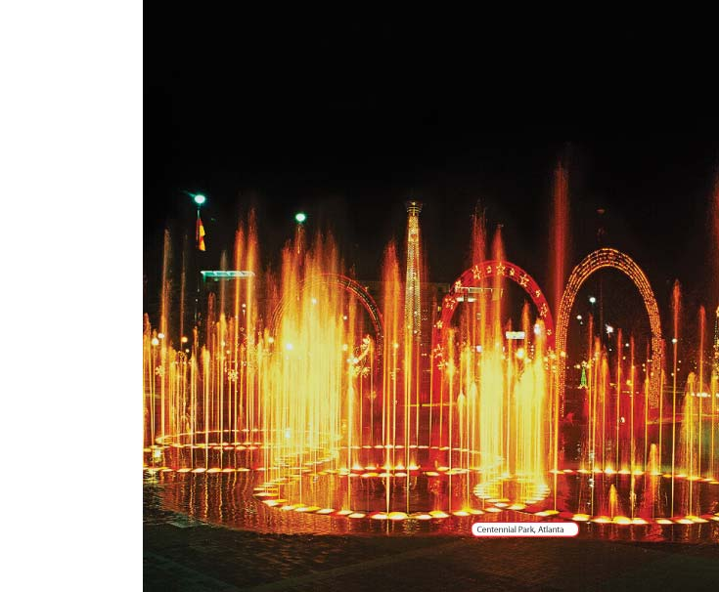
Chapter 3 Lesson 2
What Are Physical Changes in Matter?

Slide 2
Vocabulary Preview
Change of state: a physical change that occurs when matter changes from one state to another, such as a liquid to gas
Physical change: a change in which a substance remains the same substance

Slide 3
States of Matter
Have you ever seen ice cube melt in glass?
The ice becomes water.
How can water have three forms that are so different?
Well every substance on Earth can exist as a solid, as a liquid, or as a gas.
These are called the 3 stages of matter.

Slide 4
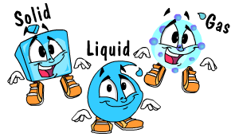
3 States of Matter

Slide 5
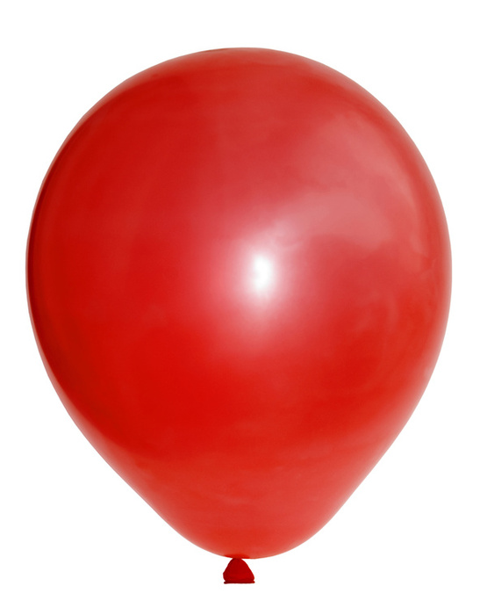
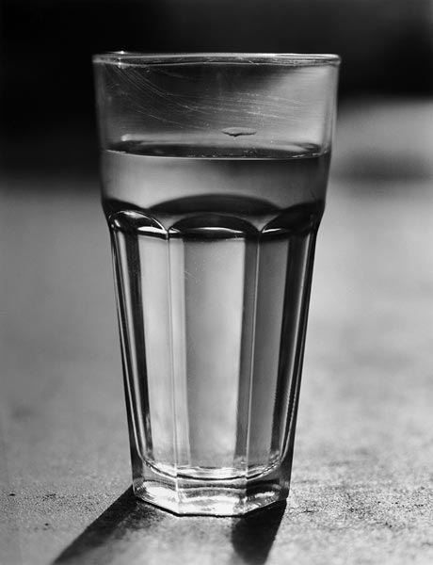
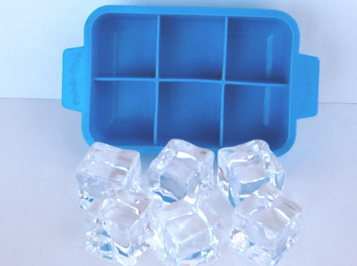
States of Matter
A change of state: occurs when a substance changes from one state to another.
Each change of state has its own name.

Slide 6
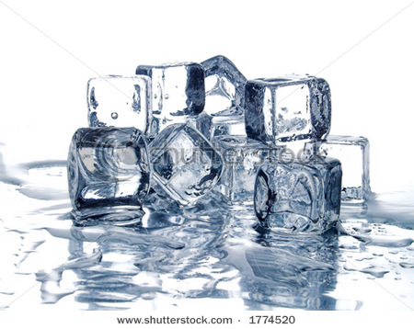
Solid to Liquid
If a solid is heated enough, it will turn into a liquid. This is known as melting.

Slide 7
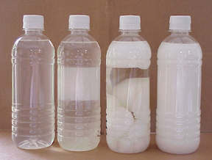
Liquid to Solid
If a liquid is cooled enough, it will turn into a solid, which is called freezing.

Slide 8
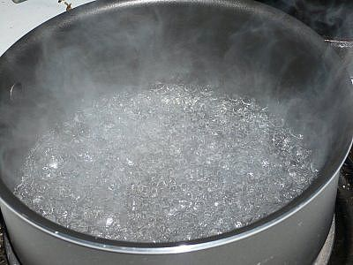
Liquid
If a liquid is heated enough, it will turn into a gas. The liquid is now boiling.

Slide 9
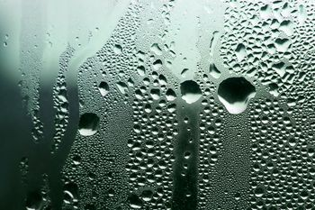
Gas to Liquid
If a gas cools, it will turn into a liquid. That gas is now condensing.

Slide 10
States of Matter
You know all matter is made up of tiny particles.
Well these particles are always moving.
Since ice, water, and the water vapor are all forms of water, they are made up of the same particles-water molecules.
The difference between them is in the way the particles move.
Ice particles don’t move around at all. They just vibrate in place.
Water particles move easily and all over.

Slide 11
Physical Changes
A physical change: is a change that does not result in a new substance.
Changes of state are example of physical changes.
So are shredding, cutting, and carving.
How do you know that a change of state is a physical change?
Well, you know that ice, water, and water vapor are all different forms of the same thing.

Slide 12
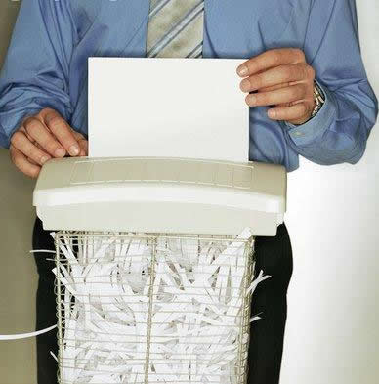
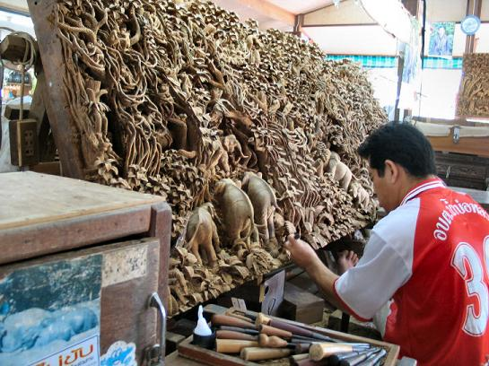
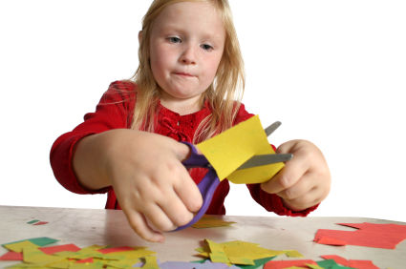

Slide 13
P Physical Changes
If ice changes to water or water changes to water vapor, no new substance is made.
So the change is a physical change.
After you shred a sheet of paper, you get shreds of paper.
And when you cut a piece of paper in two, you get two smaller pieces of paper.
The size and shape are different, but they are still paper.

Slide 14
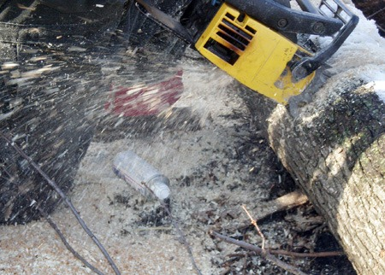
Physical Changes
The chain saw makes lots and lots of wood chips.
They’re small, but they’re still wood.
Since wood is not being changed into another substance, the change is a physical change.

Slide 15
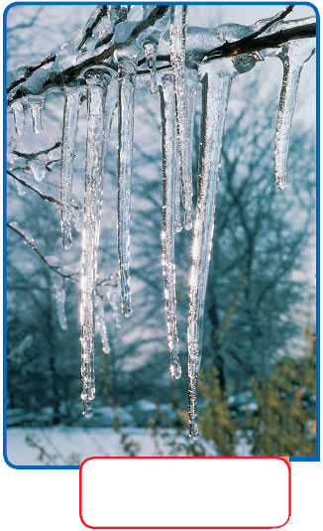
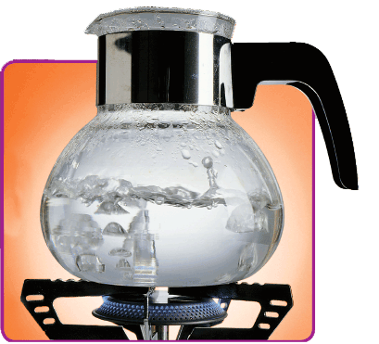
The water is boiling into water vapor, a gas you cannot see. Water and water vapor are two forms of the same thing
Both of these photos show changes of state. A change of state is a physical change.

Slide 16
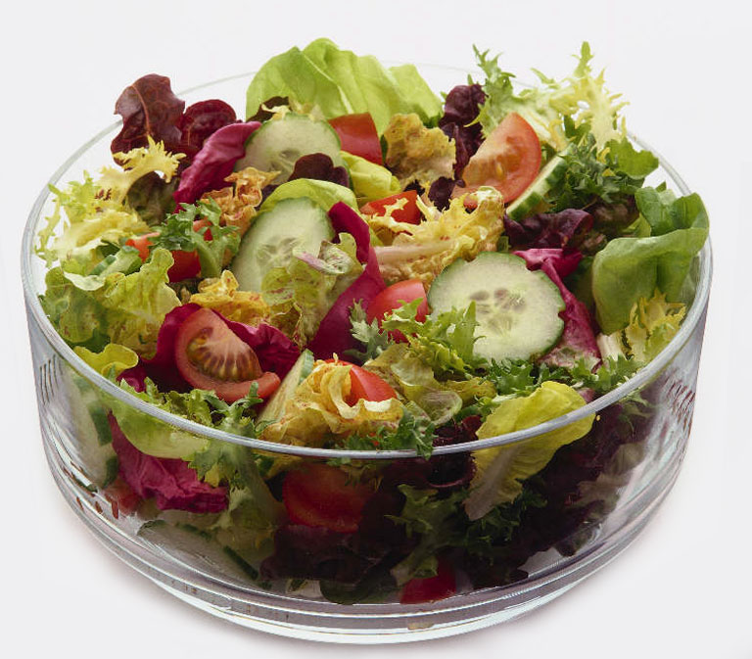
Mixtures
Do you like salad? Salad is a mixture.
A mixture is two or more substances that are combined without being changed.
The substances in a mixture aren’t permanently combined, and their properties don’t change.
They can be separated from each other again.
Ex: How many of you take onions out of your salad?

Slide 17
Mixtures
Mixtures can contain different amounts of the substances. Not all mixtures are made of solids.
Salt water is a mixture of a solid and a liquid.
Fog is a mixture of water drops and air (air contains a mixture of nitrogen, oxygen, carbon dioxide, and gases.

Slide 18
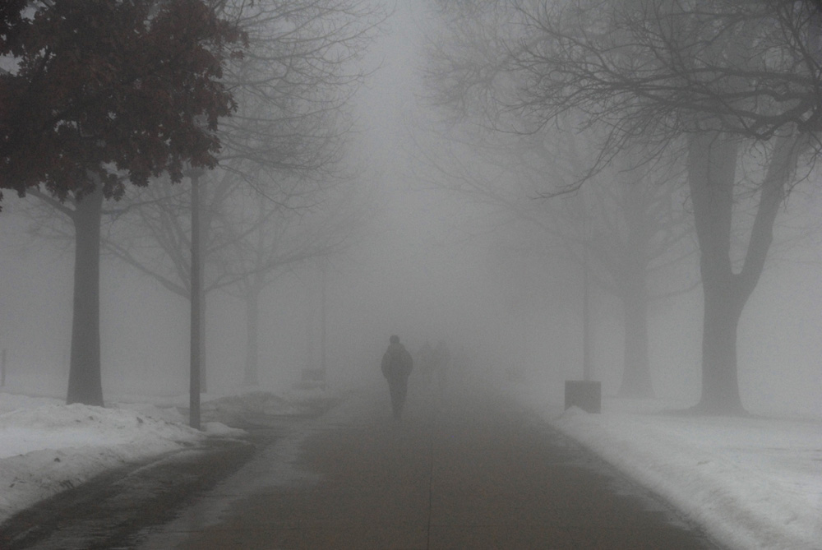
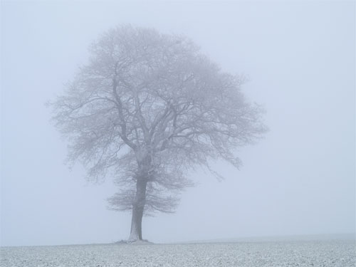

Slide 19
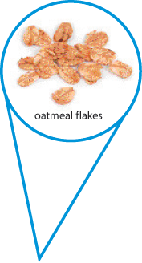
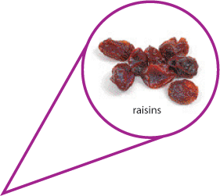
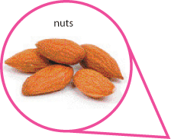
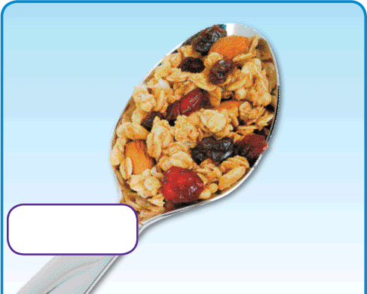
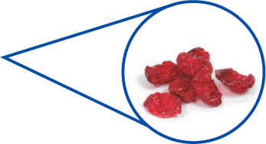
Dried Cranberries
Granola

Slide 20
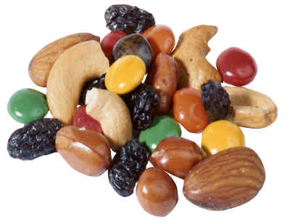
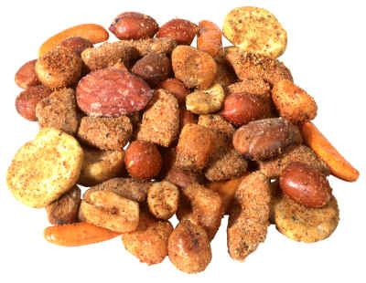
Mixtures
Most materials found in nature are mixtures.
Ex: Sand (rocks, shells)
The pictures on the next slide show how one mixture can be separated.
The mixture begins as a pile of rocks, dirt, salt, and bits of iron.

Slide 21
Mixtures
First, larger rocks and particles are screened from the mixture. Only the smaller particles can pass through the holes.
Next, a magnet draws out the iron bits. Then water is added to the remained mixture. The wet dust, dirt, and salt are poured through a filter. Water and salt pass through.
Finally, the salty water is heated. The water boils away leaving salt only .
All the substances in the mixture are separated.
Being in the mixture didn’t change them.

Slide 22
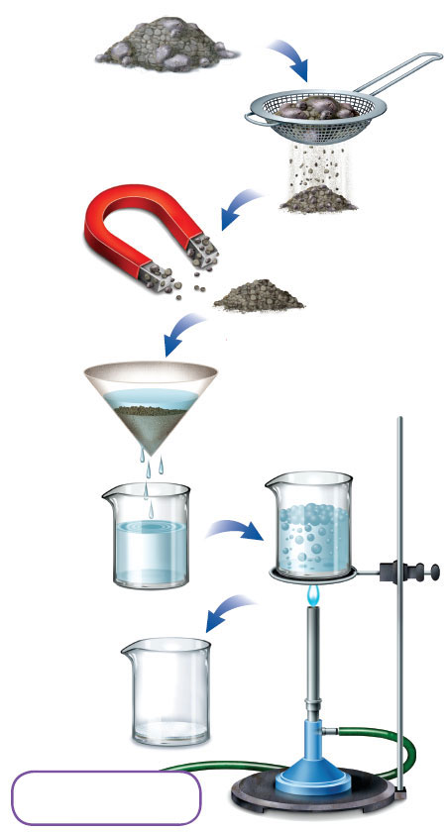
The mixture begins as a pile of rocks, dust, dirt, salt, and bits of iron. The rocks are screened out first.
Mixtures
A magnet takes away bits of iron.
Water is added. Then the filter removes dust and dirt.
The salt water is heated
The water is boiled away. Only salt is left behind.

