Slide 1
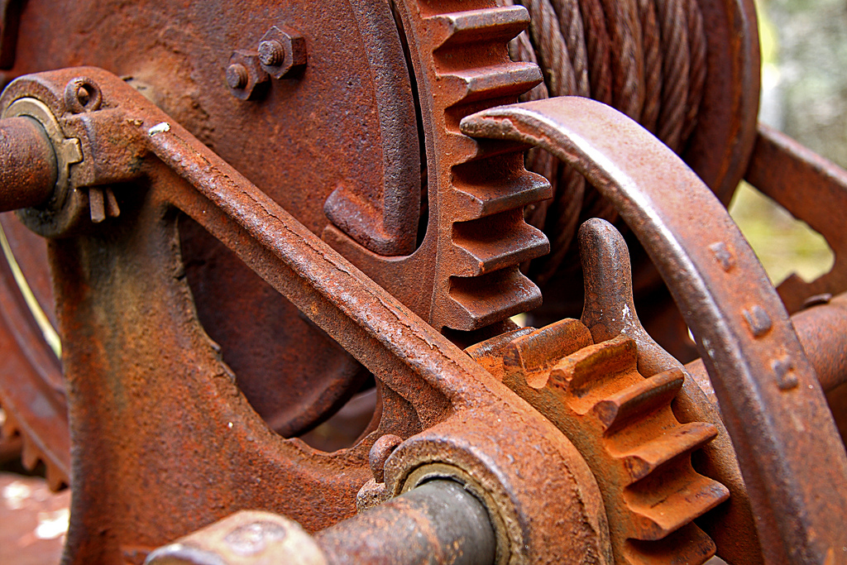
Chapter 3: Changes in Matter
Lesson 3: What are Chemical Changes in Matter?

Slide 2
Vocabulary Preview
Physical Property: a trait, like color, shape, or hardness-that describes a substance by itself
Chemical Property: a property that involves the ability of a substance to react with other materials to form new substances
Chemical Reaction: a change in which one or more new substances are formed

Slide 3
Vocabulary Preview
Chemical Change: a change in which a substance or two becomes a new substance or two
Compound: a substance made of two or more different elements
Law of Conservation of Mass: the mass of the products of a chemical reaction equals the mass of the reactants

Slide 4
Chemical and Physical Properties
How would you describe a pencil? You may say it is yellow, long, thin, and has 6 sides.
All of these traits describe the pencil.
Can you describe something in relation to another substance? Yes, you can.
You can describe something by the way it can interact with other substances.

Slide 5
Chemical and Physical Properties
Think about the wood in the pencil.
If there is oxygen near the wood and the temperature was hot enough, the wood will burn.
So another description of the pencil might be “it burns if there is enough oxygen near it and the temperature is very high”.
Now you know two ways to describe a substance.

Slide 6
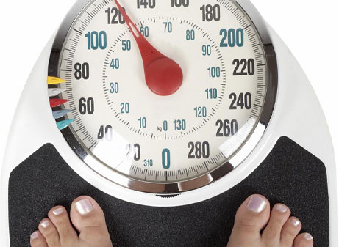
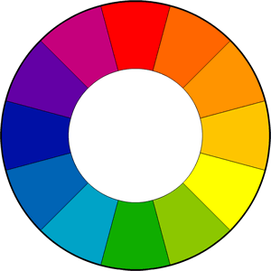
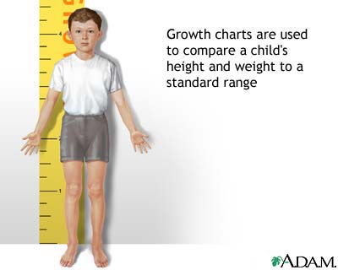
Physical Properties
One way is to describe it’s physical properties.
Physical properties: are traits that involve a substance by itself.

Slide 7
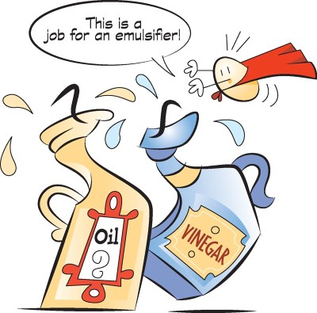
Chemical Properties
Another way to describe a substance is by describing its chemical properties.
Chemical properties: are properties that involve how a substance interacts with other substances.

Slide 8
Chemical Changes
Look at the table on the next slide.
You’re probably familiar with most of these substances.
You’re probably also familiar with some of these changes.
Have you ever seen rusted iron or tarnished silver?

Slide 9
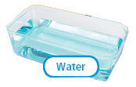
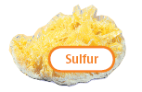
Properties of Matter | Physical Properties | Chemical Properties
 | • colorless • odorless • liquid at room temperature • boils at 100˚C • melts at 0˚C | • made up of hydrogen and oxygen • many substances dissolve easily in it
 | • shiny • soft • silver in color • boils at 2163˚C • melts at 962˚C | • does not react with many other substances • does not react with air • reacts with ozone or sulfur to form tarnish
 | • shiny • hard • grayish silver in color • boils at 2861˚C • melts at 1538˚C | • reacts with many substances • reacts with oxygen to form minerals hematite and magnetite • reacts with oxygen and water to form rust
 | • dull • brittle • yellow • boils at 445˚C • melts at 115˚C | • reacts with any liquid element • reacts with any solid element except gold and platinum • reacts with oxygen to form sulfur dioxide, a form of air pollution

Slide 10
Chemical Changes
Do you know what happens when hydrogen burns?
It combines with oxygen to form water.
This change results in a new substance-water
The formation of water is not a physical change.
A physical change does not result in a new substance.

Slide 11
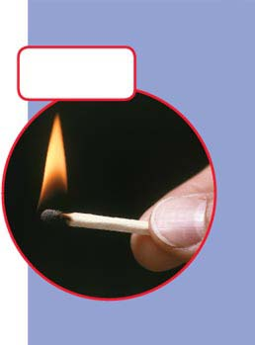
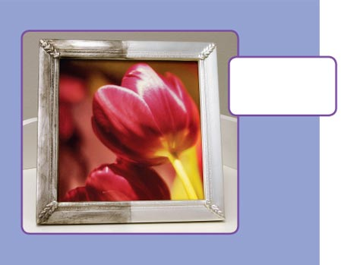
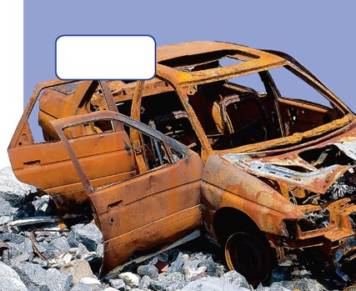
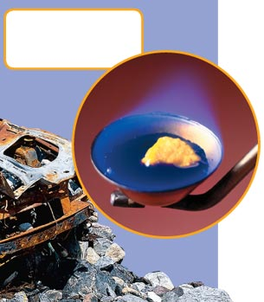
Sulfur in the match head is what helps the match light quickly
Silver reacts with sulfur to form tarnish. This helps you know that either sulfur or compounds that contain sulfur were in the air
Sulfur reacts with oxygen to form sulfur dioxide. Reacts with oxygen often means that a substance burns
Iron reacts with oxygen in the presence of water to form rust.

Slide 12
Chemical Changes
This change is a chemical change.
A chemical change: is a change that results in one or more new substances.
Another term for this is called chemical reaction: the word react means goes through a chemical change.

Slide 13
Chemical Changes
You know that an element is something made up of only one kind of atom.
Since water is made up of hydrogen and oxygen atoms, it is not an element.
It’s a compound. A compound: is a substance made up of two or more different elements that have chemically combined.

Slide 14
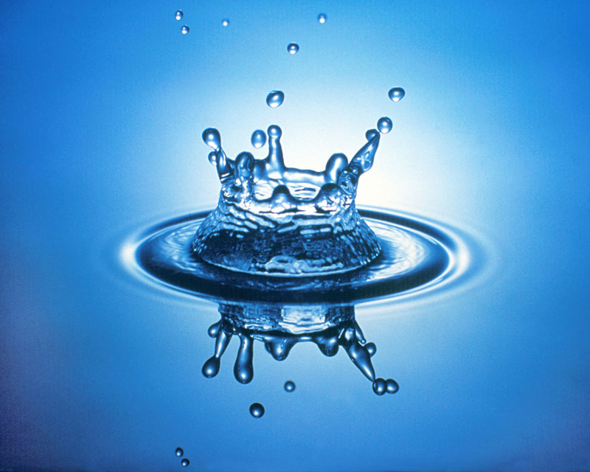
Recognizing Chemical Changes
Water is made up of two gases-oxygen and hydrogen.
They react to form a liquid.
It’s easy to see that a chemical change took place because water is a liquid, not a gas!
There are clues to look for to help you know a chemical change took place.

Slide 15
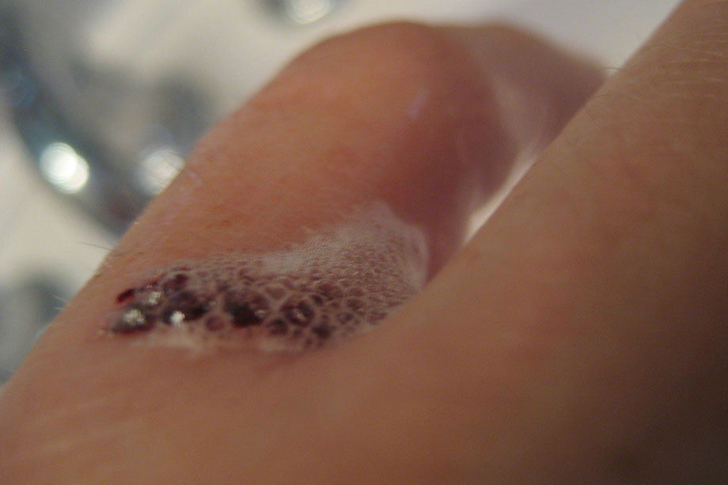
Recognizing Chemical Changes
Gas bubbles form ex: when your pour hydrogen peroxide on a cut.
A change in color may also tell you that a chemical change took place.
Fireworks are a good example of this.
When a smell occurs.
Heat is given off.

Slide 16
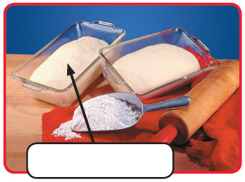
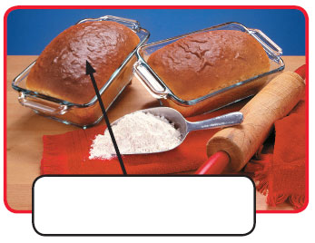
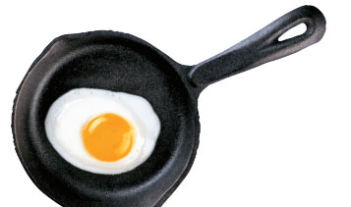
Before bread dough is baked, it’s white or very pale tan.
After the bread is baked, its crust is dark brown. That’s because baking causes a chemical change.
The smell of eggs frying tells you that a chemical change is taking place. So does seeing the egg yolk change from a runny liquid to a solid.

Slide 17
Clues to Chemical Changes
Clue | Example | Description
Color Change | Bread dough baking | Changes from white to brown
Smell | Eggs rotting | Gives off a terrible smell
New Physical Property | Iron rusting | Changes from hard and silvery to brittle and reddish brown
Substance Given Off | Wood burning | Smoke is released into the air
Heat Given Off | Sulfur burning | Fire is hot

Slide 18
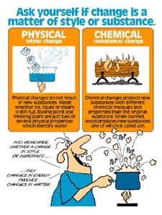
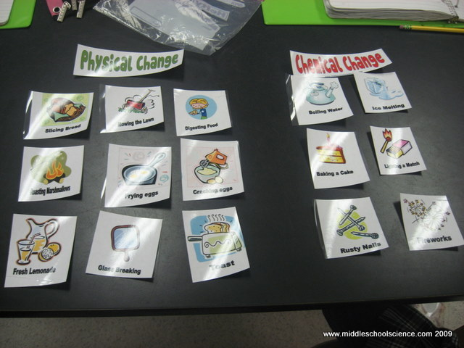
Chemical vs. Physical Change
Video Clips

Slide 19
Conservation of Matter
Chemical changes don’t make new matter.
They only make new products from the substances that react.
Ex: When you drop vinegar into baking soda, you saw bubbles
They were bubbles of carbon dioxide.
A chemical reaction between the vinegar and the baking soda caused them.

Slide 20
Conservation of Matter
Suppose you calculated the mass of the vinegar and the baking soda before you combined them.
Suppose that after the reaction, you found the mass of the vinegar and the baking soda, plus the mass of the carbon dioxide gas.
It takes some work to find the mass of a gas, but it can be done.
You would get the same number for the 2 masses.

Slide 21
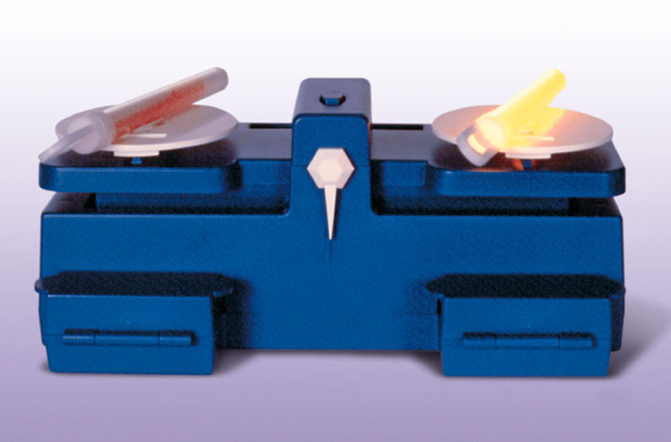
What happens to the mass of a glow stick when a chemical reaction causes it to light?
Nothing, it stays the same.

Slide 22
Conservation of Matter
The total mass of the products that form equals the total mass of the substances that react.
This is called the law of conservation.
When iron corrodes, it gains mass, so it might appear that the chemical change made more mass.
But you must take into account the mass of the oxygen in the air combined with the iron to form the rust.

Slide 23
Conservation of Matter
When you do, you find that the two amounts are the same. Matter is conserved.
A marshmallow has less mass after it is burned than it did before.
Was matter destroyed?
No, it went into the air as water vapor and carbon dioxide gas.
The mass of the burned marshmallow plus the mass of the gases is the same as the mass of the marshmallow before it was burned.

