Slide 1
Civil Rights
Jeopardy
Hosted
by
Mrs. Dibert

Slide 2
Laws
Important People
Civil Rights Events
Misc.
Other
100
100
100
100
100
200
200
200
200
200
300
300
300
300
300
400
400
400
400
400
500
500
500
500
500

Slide 3
Jim Crow Laws
These laws segregated African Americans
in every aspect of life. The passage of the
Civil Rights Act ended the use of these.
Row 1, Col 1

Slide 4
Rosa Parks
I am a famous African
American who refused to
give up my seat on a city
bus to a white person.
I was arrested which led
to the Montgomery Bus Boycott.
1,2

Slide 5
Montgomery Bus Boycott
This event led to the US Supreme
Court outlawing segregation
of all transportation in the city. It
was a citywide boycott of the bus
system organized by African
Americans.
1,3

Slide 6
Montgomery Bus Boycott, Brown v. BOE, and Freedom Rides
Name 3 examples of successful
non-violent Civil Rights
events that changed public policy.
1,4

Slide 7
Voting Rights Act
This act which made it
illegal to use literacy tests or
poll taxes to vote
2,1

Slide 8
Martin Luther King, Jr.
I encouraged others
to gain civil rights through
non-violent, peaceful
protests. I gave my famous
“I Have a Dream,” speech at the
March on Washington.
2,2

Slide 9
Civil Rights Movement
This movement in the US sought
to gain equal rights for all
citizens as written in the Constitution.
2,3

Slide 10
He was assassinated
What happened to JFK on
Nov. 22, 1963 while riding
in his convertible in a
parade in Texas?
2,4

Slide 11
Civil Rights Act
This act, passed by Lyndon B.
Johnson, banned discrimination
because of race, religion, or
gender. It also outlawed
segregation of public places
and enforced school integration.
3,1

Slide 12
Thurgood Marshall
I was the attorney on the
Brown v. BOE court case
and I later became the first
African American Supreme
Court justice.
3,2

Slide 13
March on Washington
The goal of this event
was to end segregation and
gain fair wages and employment.
This is where MLK jr.
gave his famous “I Have a
Dream” speech. This led to the
Civil Rights Act of 1964 being
passed.
3,3

Slide 14
The nation was shocked and wanted a return to law and order
What was the result of the three
assassinations in the 1960s?
3,4

Slide 15
Brown v. BOE
In this famous court case, the
Supreme Court made it so
segregation in public schools
was illegal.
4,1

Slide 16
Martin Luther King, Jr.
This person was assassinated on a
Motel room balcony. His
death led to riots all
over the country.
4,2

Slide 17
Cesar Chavez
This person worked to improve
rights and working conditions for
migrant farm workers and started
a grape boycott.
4,3

Slide 18
Television
This changed the way Americans
saw themselves and the world
because it brought the world right
into their living rooms
4,4

Slide 19
Lyndon B. Johnson
This president signed the
Civil Rights Act and the
Voting Rights Act into law
to continue JFK’s legacy.
5,1

Slide 20
Robert Kennedy
I was a US senator who was
assassinated while on
campaign to run for president.
My big brother was also killed
this way.
5,2

Slide 21
They all worked towards Civil Rights and were assassinated
What 2 things do John F. Kennedy,
Robert Kennedy, and Martin
Luther King, Jr. have in common?
5,3

Slide 22
Soviet Union
This country was the first to
put a man in space.
5,4

Slide 23
To put a man on the moon
JFKs major goal for the space program in the 1960s

Slide 24
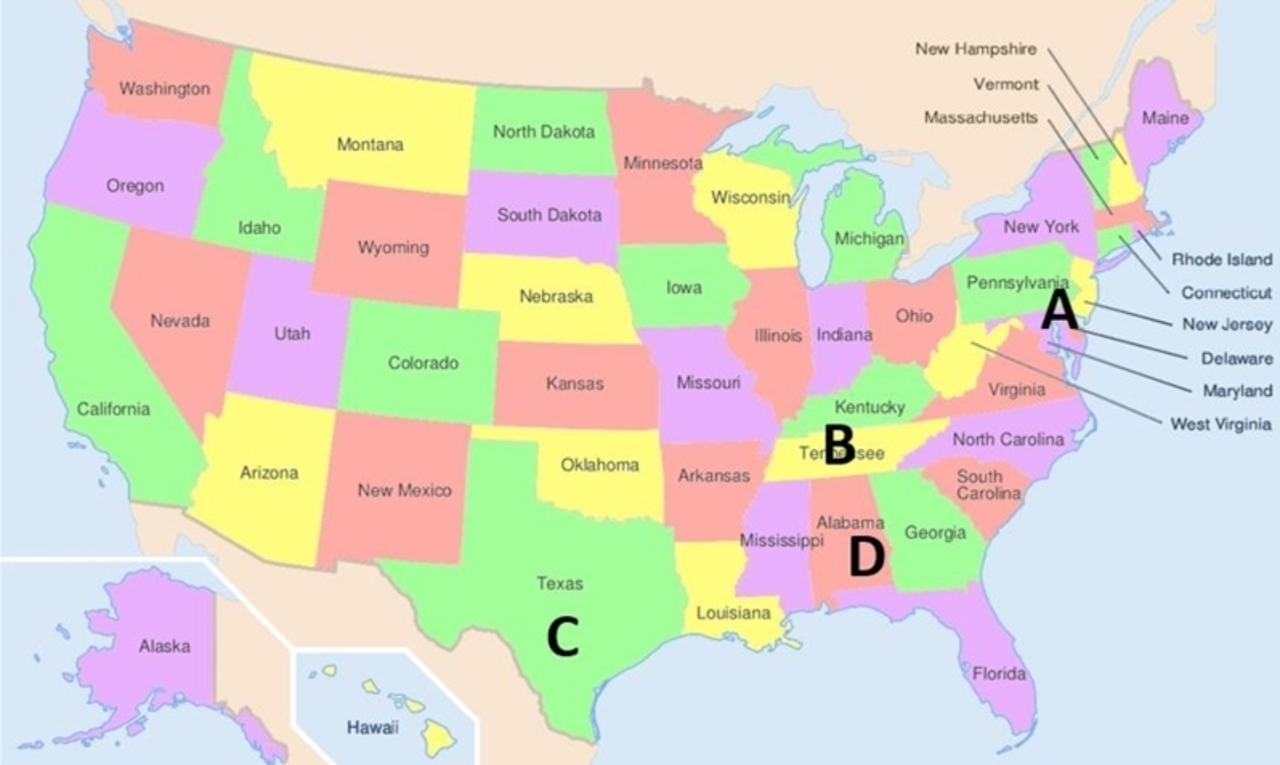
Montgomery, Alabama
What city is located at point D?

Slide 25
Neil Armstrong; USA
What was the name of the first man on the moon? What country was he from?

Slide 26
24th
This amendment outlawed the use of Poll Taxes in federal elections.

Slide 27
Kennedy’s dream of putting a man on the moon and helping the nation recover from tragedy
After Kennedy’s death the space program was continued to help what 2 things?

