Slide 1
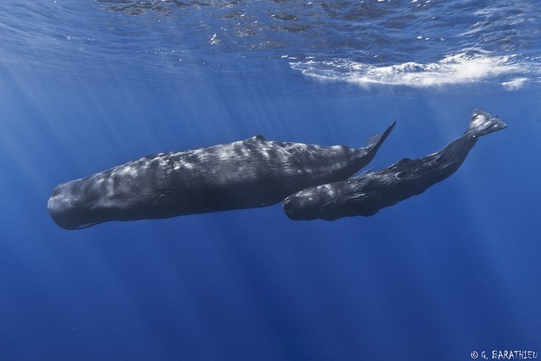
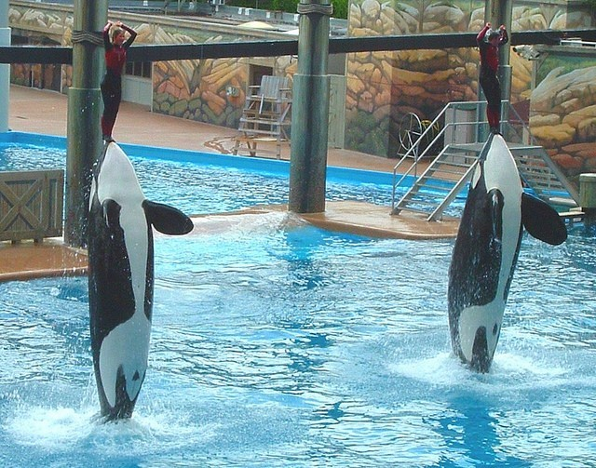
Inherited and Learned Behaviors

Slide 2
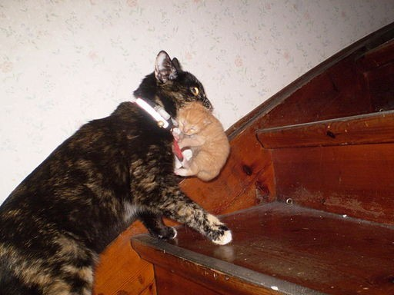
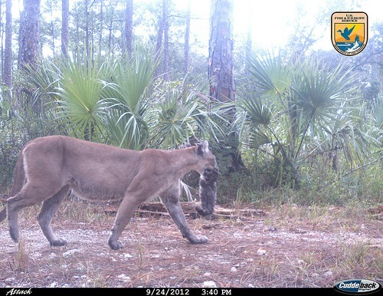
Inherited Behaviors
●
Also called instincts
Passed down to offspring from parents
Not learned Can affect a
plant's or animal's
ability to survive
●
●
●

Slide 3
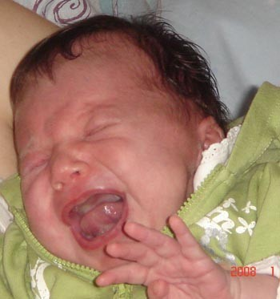
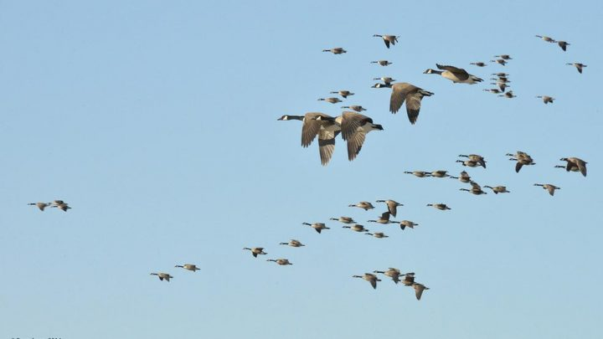
What are some examples of inherited behaviors...
Birds flying in groups.
Babies crying when hungry.

Slide 4
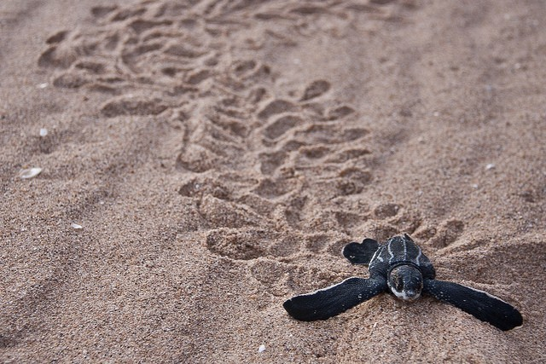
Baby turtles move to the ocean when they hatch

Slide 5
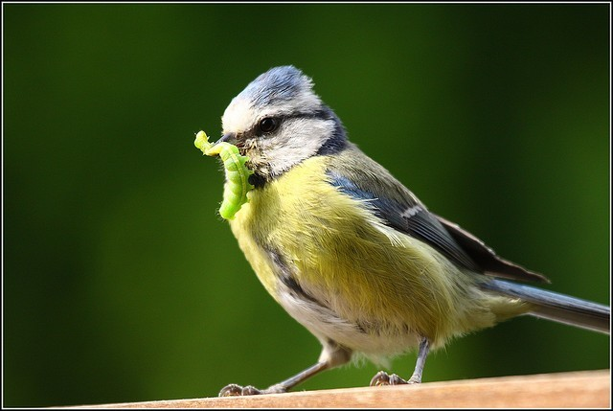
But when the environment changes...
Living things will learn to adapt to the changes in their habitat or they might die.

Slide 6
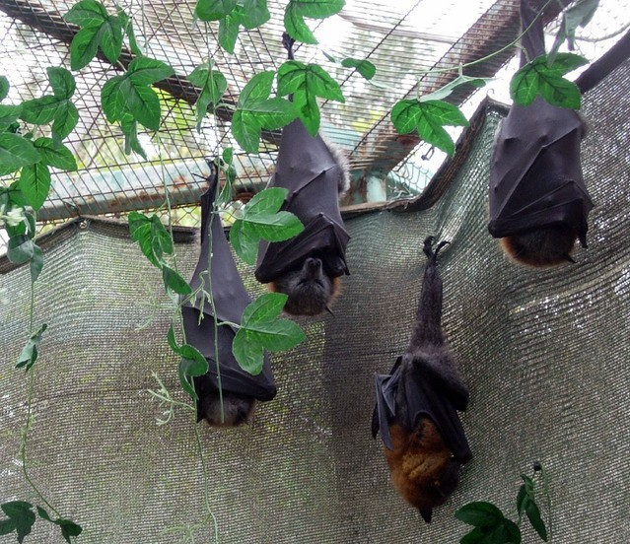
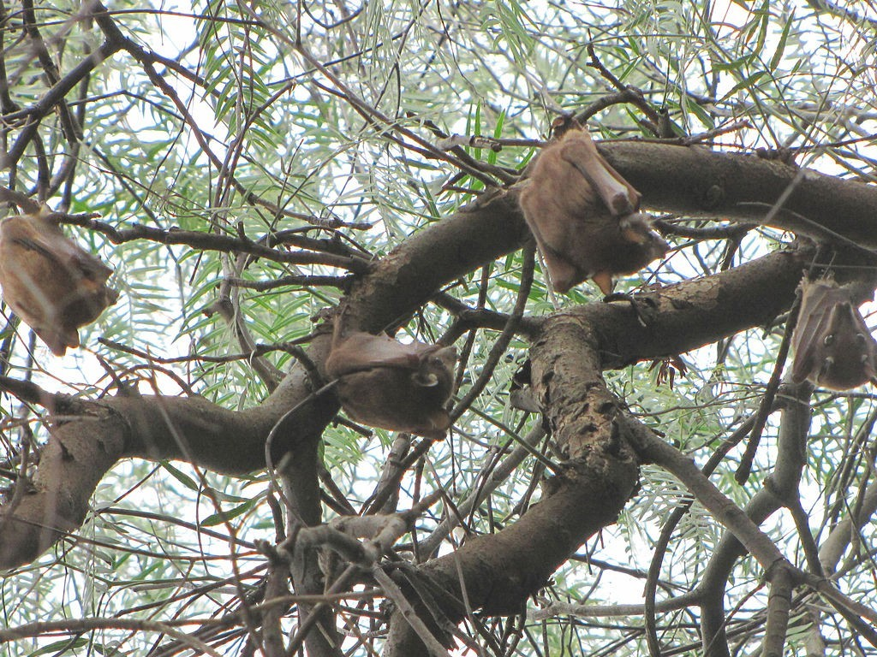
For example...
In nature, bats will hang upside down
Sleeping
upside down is an inherited behavior.
in trees to sleep.
When placed in a zoo, bats use the screen to hang.
They still sleep upside down though!

Slide 7
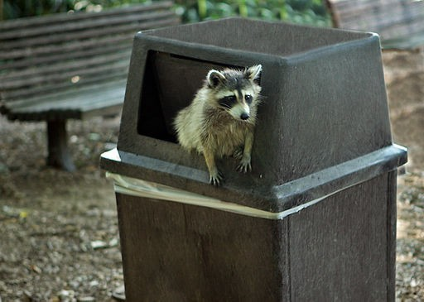
How do animals adapt?
As animals live and move in their
environment, they interact and experience new and different things. If they encounter something they enjoy, an animal may repeat it!

Slide 8
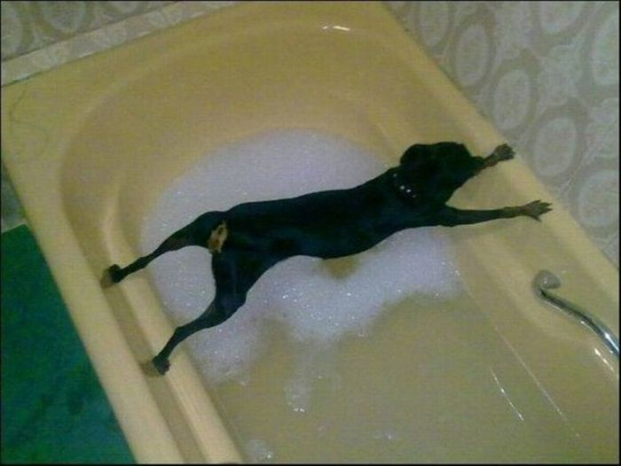
If they encounter something they don't like, they could start to avoid it
Sometimes it's not about what they want, it's about changing just to survive.

Slide 9


What are some examples of learned behaviors?

Slide 10
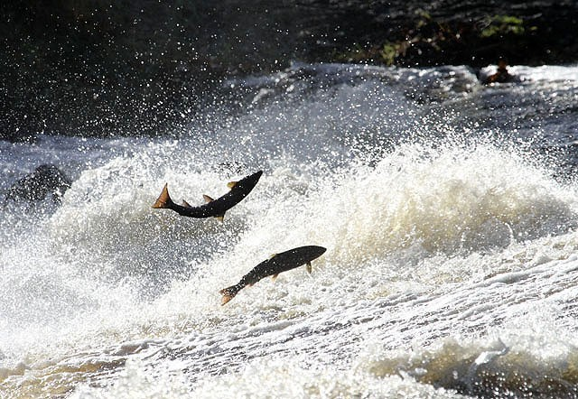
Review –Instinctive behaviors
●
Aren't learned
passed down from parents
can't be changed.
●
●
---- Examples -----
Birds flying south Bears hibernating fish swimming
Sleeping when tired
●
●
●
●

Slide 11
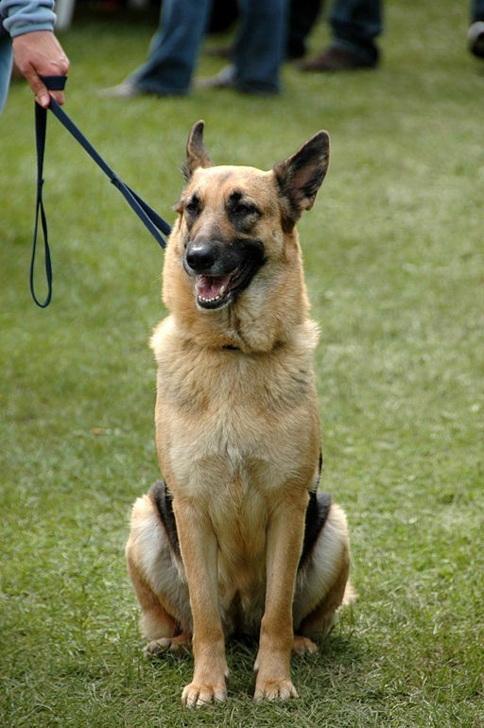
Learned behaviors...
●
Something an animal learns as they interact with their world.
Can be changed.
Can occur when an animal seeks to avoid or repeat a new experience.
●
●
Give some examples...

