Slide 1

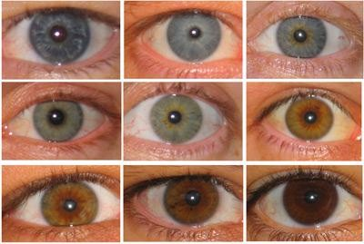

Slide 2

At the end of the lesson, you’ll know...
Are the eyes on his face…
inherited or
acquired?

Slide 3




Characteristics = Traits
You are a unique individual.
Thousands of characteristics make you who
you are.
Characteristics are also called traits.
  Examples: Eye color, basketball skills, height

Slide 4
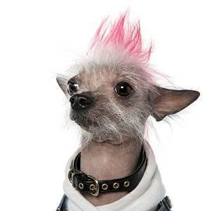
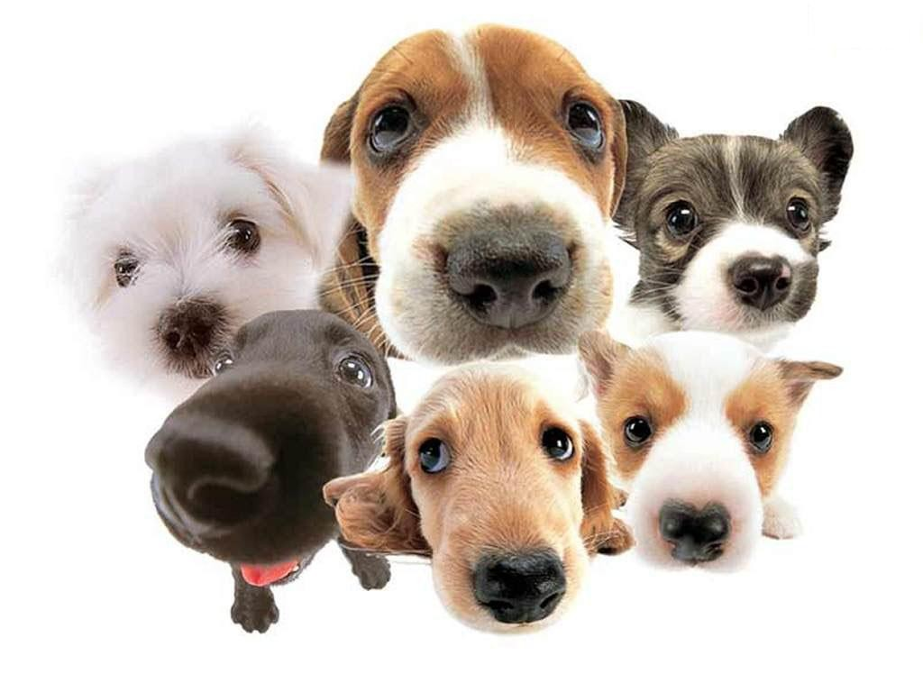
Traits can be physical…
Physical traits
describe the way something looks
describe the internal structure
  Fur color
  Ear shape
  Number of legs
  Color of eyes

Slide 5

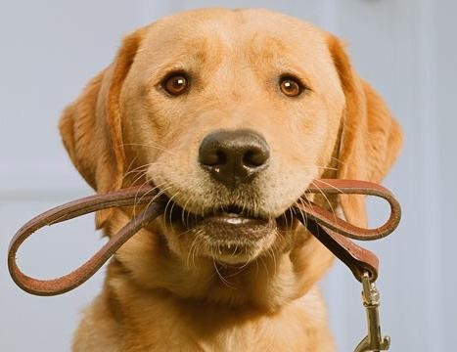
Traits can be Behavioral…
Describe the way something acts
Describe something that was learned
  Fetching things
  Migration
  Language

Slide 6


Types of Traits
A characteristic of an organism may be
or

Slide 7
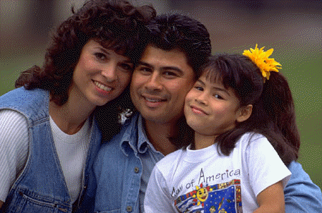
Inherited Traits
Inherited traits are coded in your DNA
You received from you biological parents
Sometimes called instinct
Examples: eye color, hair color, height, blood type, birds flying south for the winter
Because inherited traits are coded in the DNA, they can be passed on to the next generation

Slide 8


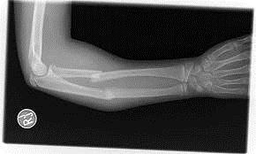
Acquired Traits
Acquired traits develop during life
(an organism is not born with it)
Not in your DNA
Examples
  Things you learned
(riding a bike, reading, writing)
  Things that happened to you
(short hair, broken bone)

Slide 9
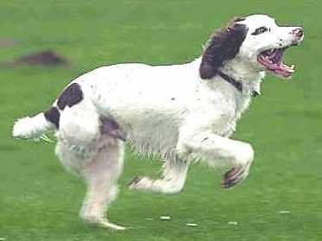
Acquired traits end with you!
Acquired traits cannot be
passed on to offspring
Organisms develop
acquired traits
They are NOT in DNA/genes!
Example: This dog’s puppies won’t be missing a leg just because he is!
Three-legged dog

Slide 10

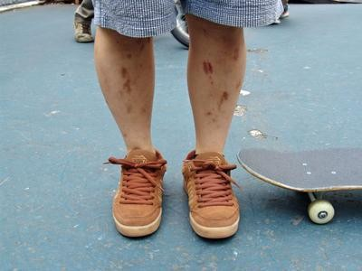
Physical traits can be both
Inherited
Acquired
(eye color)
(scars)

Slide 11
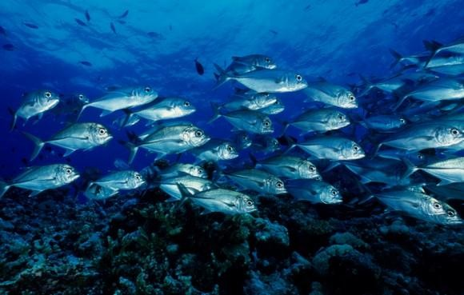
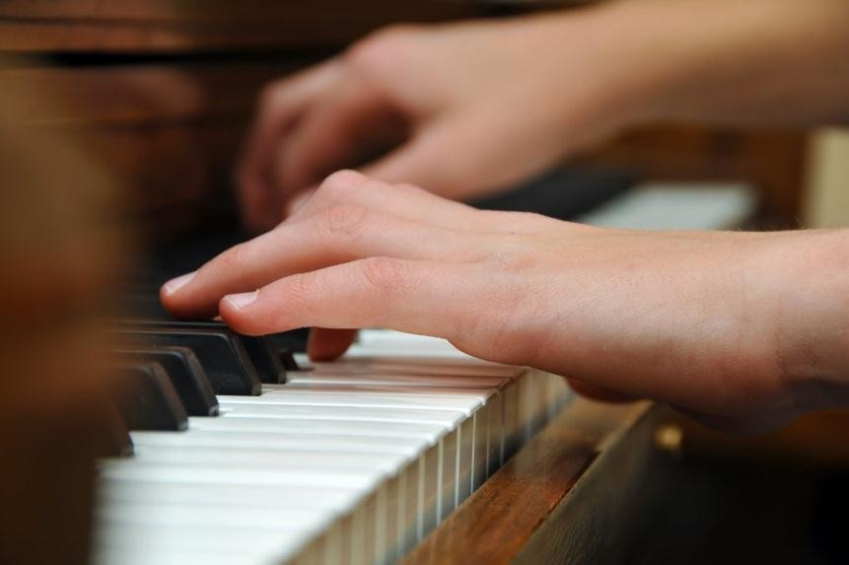
Behavioral traits can be both
Inherited
Acquired
(fish swim)
(playing the piano)

Slide 12


Some traits are both!
Skin color is a combination
trait
  Inherited part: Receive genes for skin color from parents.
  Acquired part:
Amount of time in the sun determines level of tan.

Slide 13
Let’s Practice!
For each example, identify whether you think the trait is
Physical inherited | Behavioral inherited
Physical acquired | Behavioral acquired
Think:
“Was this organism programmed from birth to have this trait?” Inherited!
“Did the trait develop during its life?” Acquired!

Slide 14

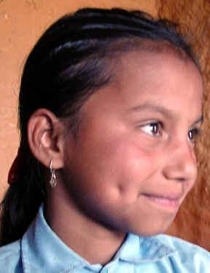

Dimples
Example:

Slide 15


Number 1
Ian is bilingual.

Slide 16

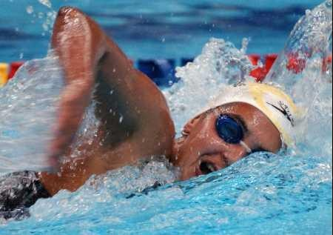
Number 2
You know how to swim.

Slide 17
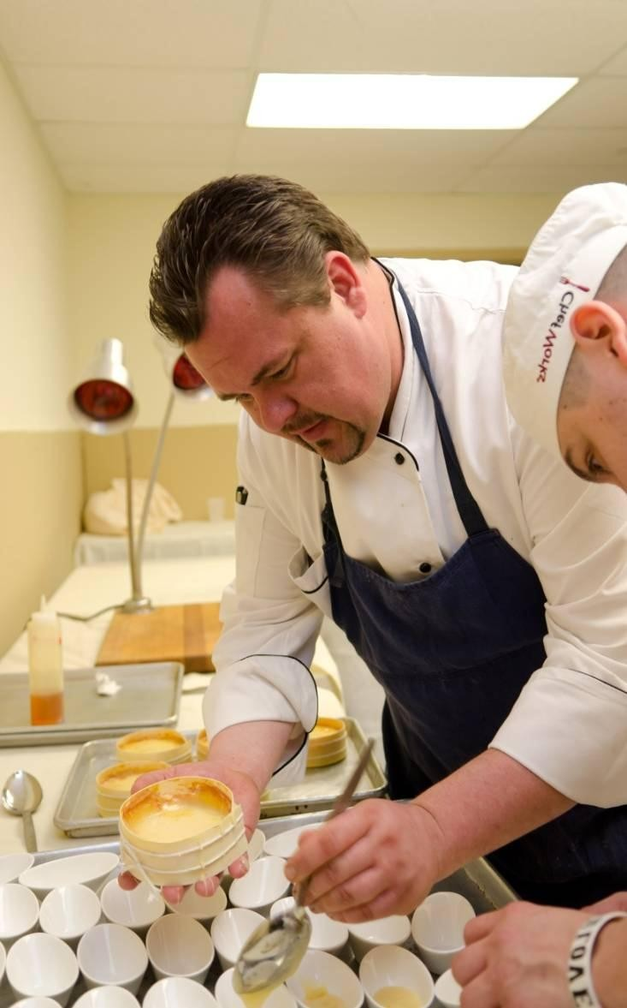

Number 3
Jason is a good cook.

Slide 18

Number 4
Captain Kirk can make the vulcan hand sign.

Slide 19
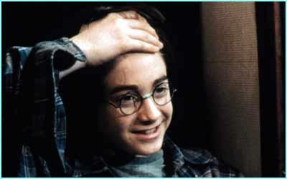
Number 5
Harry has a scar on his head that voldermort gave him.

Slide 20
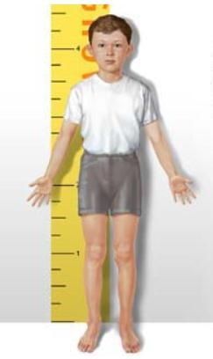

Number 6
How tall you are.

Slide 21

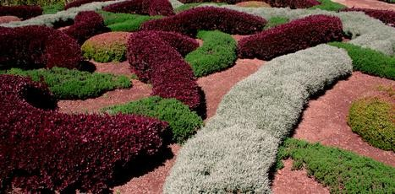
Number 7
A bush is trimmed into cool shapes.

Slide 22
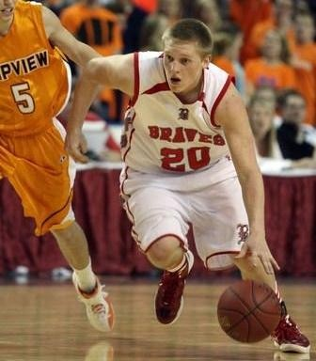
Number 8
Jarom is very good at basketball.

Slide 23
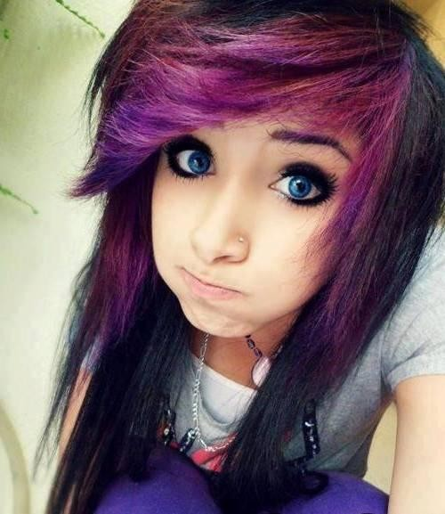
Number 9
Girl with
purple hair

Slide 24
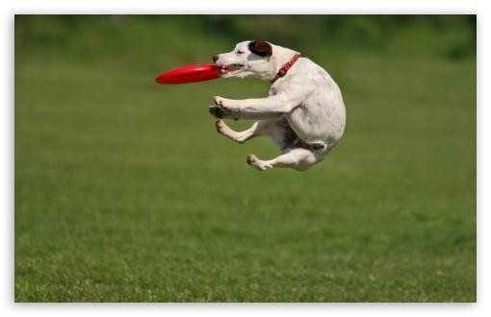
Number 10
You trained your dog to catch a frizbee

Slide 25
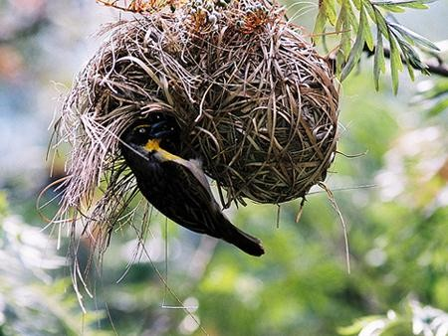
Number 11
Building a nest and sitting on eggs

Slide 26
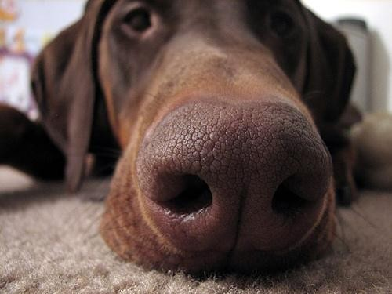
Number 12
Good sense
of smell

Slide 27
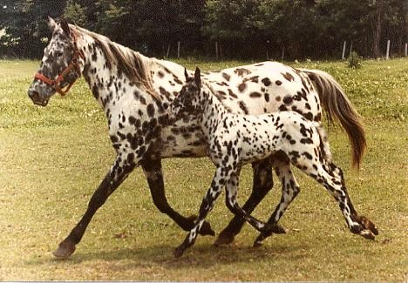

Number 13
Spots on coat

Slide 28
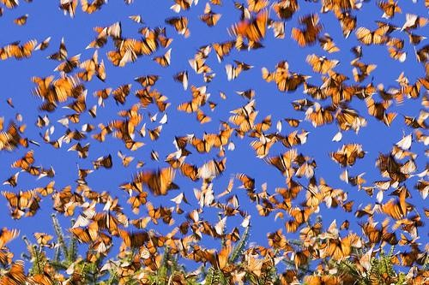
Number 14
Butterfly
migration

Slide 29

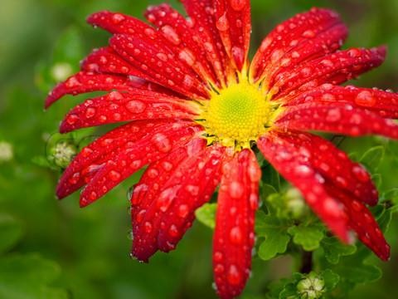
Number 15
Flower petal
color

Slide 30
Summary
A trait is a characteristic of a living thing.
There are inherited traits and acquired traits (learned behaviors)
Inherited Traits | Acquired Traits (Learned Behaviors)
Characteristics passed down to you by a parent | Characteristics that you have learned and practiced

