Slide 1
Lesson 2: What makes a circuit?
Standards: S5P3b Determine the necessary components for completing an electric circuit.

Slide 2
Vocabulary Preview
Electric Current
Electric Circuit
Series Circuit
Parallel Circuit
Resistance
Short Circuit

Slide 3
Moving Charges
Another kind of electricity is current electricity.
When electric charges have a path to follow, they flow or move.
A flow of electric charges is called electric current.
It is like a moving stream.

Slide 4
Electric Circuit
An electric circuit is a closed path that electric current follows.
A battery is a very important part of a circuit.
It provides the energy to move the electric charges through the circuit.
The energy will change to light and heat by the bulb.

Slide 5
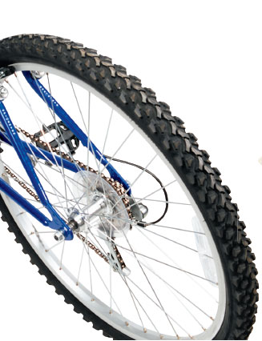
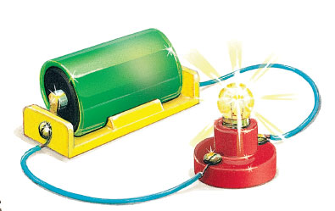
Electric Circuit
An electric current in a circuit moves like a bike wheel. The energy of motion moves through the whole wheel at once. When you connect a circuit, a battery moves energy to all parts of the circuit at the same time.

Slide 6
Series Circuit
A series circuit has only one path for its current to follow.
It is like the Ferris Wheel.
Once you are on it, you have to go all the way around to get back to the start.
A series circuit can have more than one bulb.
It can have a buzzer or other devices.
The order of the devices doesn’t matter.
The current moves through the wire and the battery is its power supply.

Slide 7
Series Circuit
Next, it will pass through each device.
Then it returns to the battery.
In this type of circuit, the same amount of current moves through each device.
Removing any device breaks the circuit.
All of the devices stop working.

Slide 8
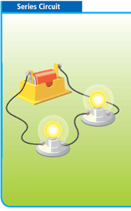
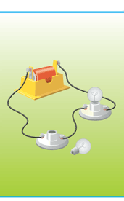
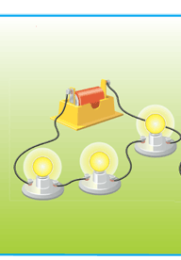
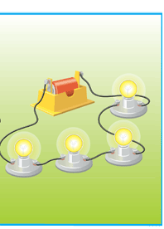
Series Circuit
Ex: Christmas Lights
A closed series circuit can light up two or more bulbs.
If the circuit is open at any point, neither bulb will light up.
These bulbs are dimmer than those in the two-bulb circuit.
These bulbs are dimmer than the bulbs in the three-bulb circuit

Slide 9
Parallel Circuit
Instead of giving the circuit one path, you can make a path for each device in the circuit.
A parallel circuit: has more than one path for the circuit to follow.
If something blocks the charges along one path, the charges keep following along another path.

Slide 10
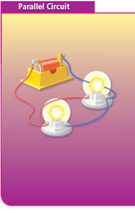
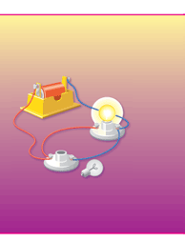
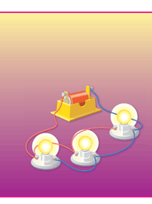
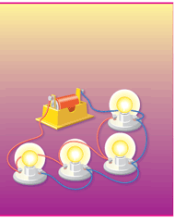
Parallel Circuit
If a part of the circuit is blocked or missing, the current can take a different path. Other devices in the circuit still work.
The bulbs in the two-, three-, and four bulb circuits are the same brightness.
If all parts are working, the current will flow through all paths and all devices will work.
In a parallel circuit, the current splits between the different paths. Adding bulbs to a parallel circuit doesn’t change the brightness of each bulb

Slide 11
Resistance
The amount of current that can flow through a circuit depends on resistance.
Resistance: is how much a material opposes the flow of current
The greater the resistance, the less current can pass through a circuit.
Thin wire has greater resistance than thick.
Light bulbs and other devices have higher resistance than copper wire.

Slide 12
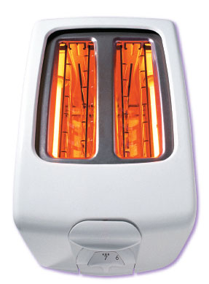
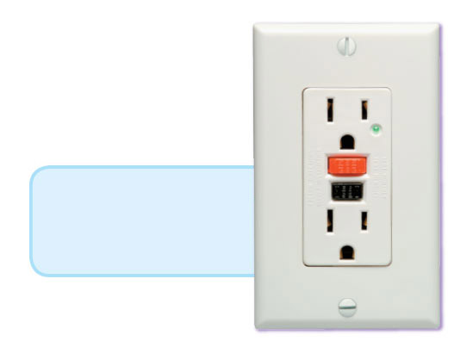
Resistance
The wires in a toaster have high resistance compared to the copper wires in the circuits that you built. The high resistance causes the wires to get hot enough to toast bread.
Some outlets have a built-in circuit breaker. If there is a short circuit or if the wires overheat, the red button pops out, breaking the circuit

Slide 13
Short Circuit
The current takes a short cut or a short circuit.
This is when a current flows where it isn’t wanted.
Short circuits prevent the rest of the circuit from working properly.
They have low resistance and high current, so they produce a lot of heat.

Slide 14
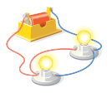
CRCT Questions
What two things are needed to make current flow in a circuit?
Wires and light bulb
Current source and closed path
Current source and light bulb
Battery bulb
2. Why are parallel circuits more useful in more applications than series circuit are?
Parallel circuits are cheaper to build.
They allow many appliances to be used at one time.
Parallel circuits take up less room.
Series circuits produce short circuits, but parallel circuits don’t.

Slide 15
Answers
1. B, a current source and a closed path.
2. B, they allow many appliances to be used at one time.

