Slide 1
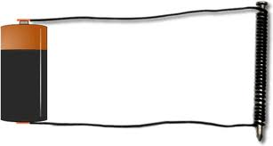
Chapter 4 Lesson 4
What makes an electromagnet?

Slide 2
Vocabulary Preview
Electromagnet: a magnet that has coils of current-carrying wire around an iron core

Slide 3
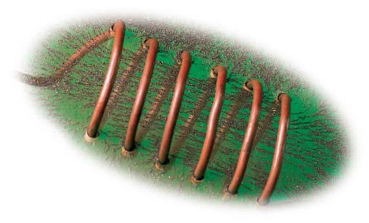
Making a magnetic field
You know that electric charges produce a force that can push or pull.
Magnets also produce a force that pushes and pulls.
Are electricity and magnetism related?
This coil of wire is carrying an electric current. Iron filings show the shape of the magnetic field inside the coil. The lines of filings are closest together where the field is strongest.

Slide 4
Making a magnetic field
If you sprinkle iron fillings around a piece of cooper wire, no magnetic field appears.
If you run a current in the wire, a magnetic field forms around the wire.
The field around one wire is weak.
The field gets stronger if you wrap the wire into a tight coil.
Iron fillings inside/around the coil show the field.

Slide 5
Making a magnetic field
The magnetic field around a wire that carries current looks different from the field around a bar magnet.
The magnetic field around a current-carrying wire can move a compass needle.
One way to make a field stronger is to wrap the wire around magnetic material, such as an iron nail.
The material inside the coil of wire is called the core.

Slide 6
Making a magnetic field
Today we are going to wrap a coil of wire around an iron nail.
When we attach the battery, an electric current will run through the wire.
The nail will become the magnet that has coils of current-carrying wire around an iron core and it is called an electromagnet.

Slide 7
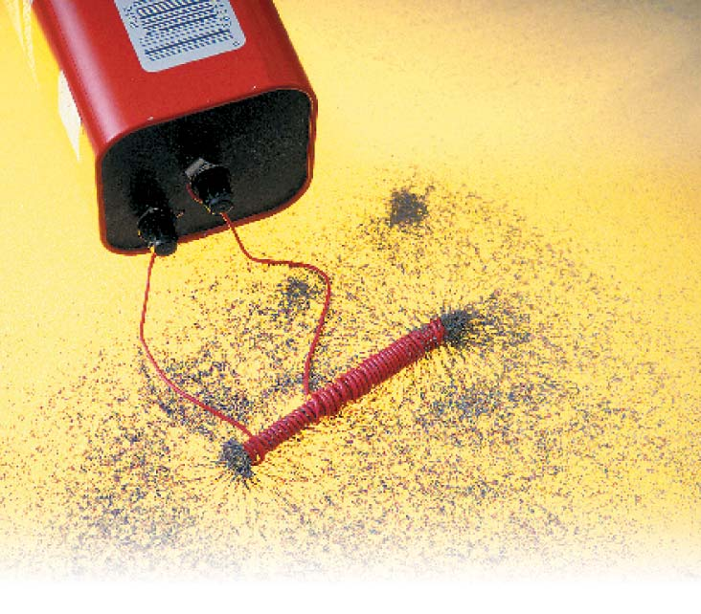
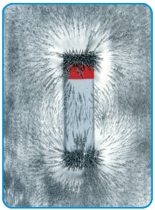
An iron nail is not normally a magnet. It becomes one when an electric current runs around it. How can you tell that this nail is now a magnet? What would happen if you took one end of the wire off the battery?
Notice that the filings collect around the poles of the bar magnet like they do to the nail in the electromagnet.

Slide 8
Controlling Electromagnets
An electromagnet is a temporary magnet.
One way to control it is to turn it on and off.
Ex: A very powerful magnet can be used to pick up tons of iron and steel scrap in a junkyard.
By turning the electromagnet on and off, a worker can pick up the metal in one place and drop it off in another.

Slide 9
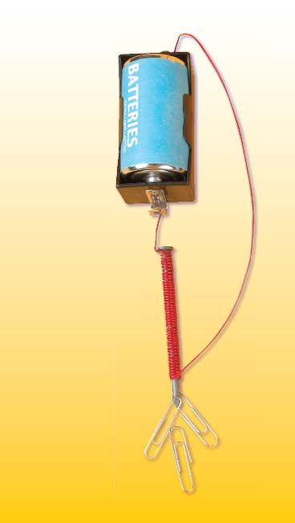
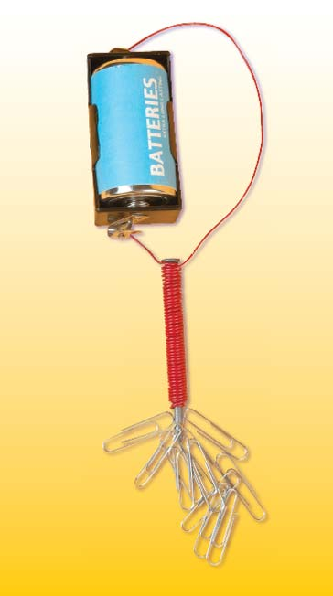
The strength of an electromagnet depends on the number of coils of wire around the core. Count the paper clips and the coils
This electromagnet is the same as the one to the left except that it has more coils. There are two layers of coils. Count the paper clips and coils. Remember to double the number of coils you see.

Slide 10
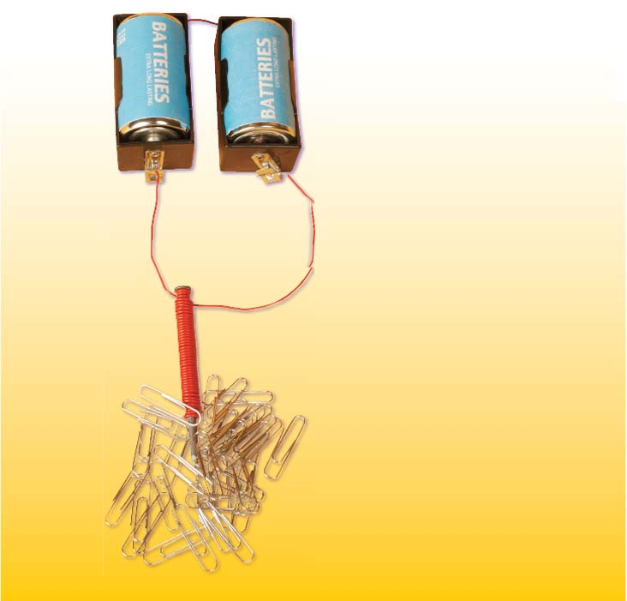
Controlling Electromagnets
There are two makes to make an electromagnet stronger.
One way: the more coils you use, the stronger the magnet becomes
Second way: increase the strength of an electromagnet by increasing the electric current (add more batteries)

Slide 11
Controlling Electromagnets
Electromagnets are an important part of many kinds of technology, from telephones to construction equipment.
People use many electromagnets everyday, often without knowing it.

